Slide 1

NightRide
Presentated by TechPalz

Slide 2
TechPalz
NightRide
This project is centered around GPIO(General Purpose Input Output), its an innovative initiative designed to tackle critical “Road accidents”.Through the versatile capabilities of GPIO, we have deployed a solution that addresses this issue or challenge.

Slide 3
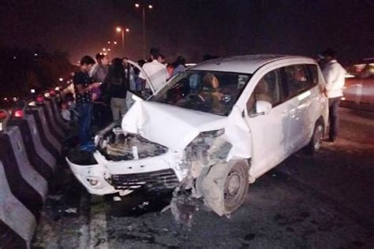
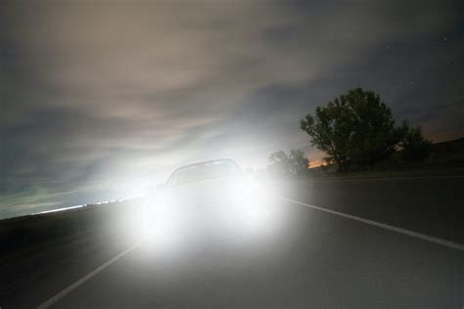
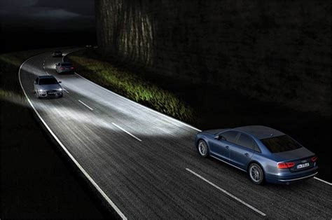
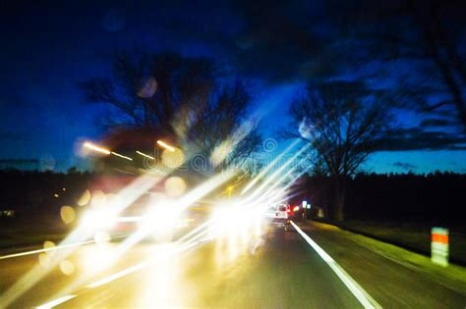
Problem!
NightRide

Slide 4

Problem

Slide 5


Solution

Slide 6
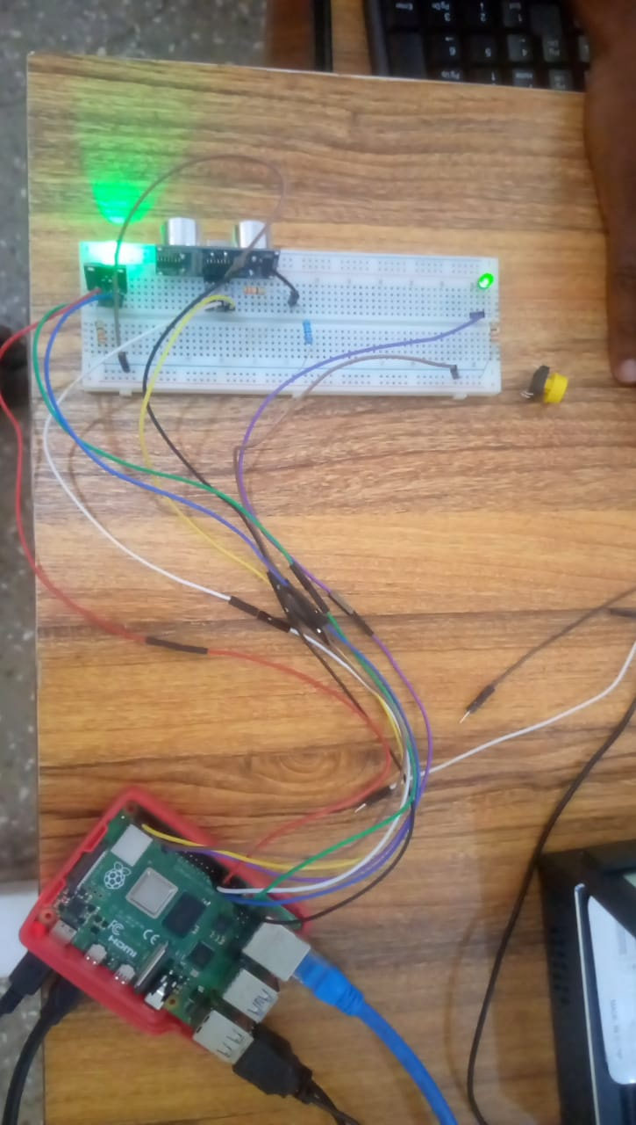
NightRide

Slide 7




Technology Used:
Ultrasonic sensor
RGB Led
Photocell sensor
GPIOzero

Slide 8
How it works
Demo

Slide 9



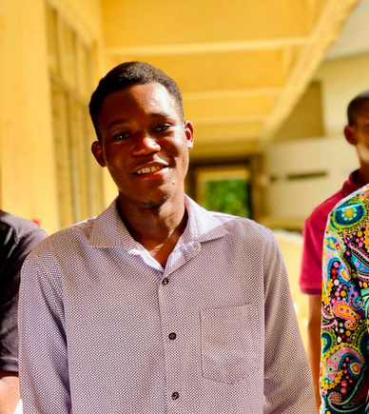
Our Team
Theodore Delali Ahiabor
Dzidula Jubilee Gati
Daniel Amenyogbele
Issaka Sadick

Slide 11
TechPalz
Thank you

